Slide 1
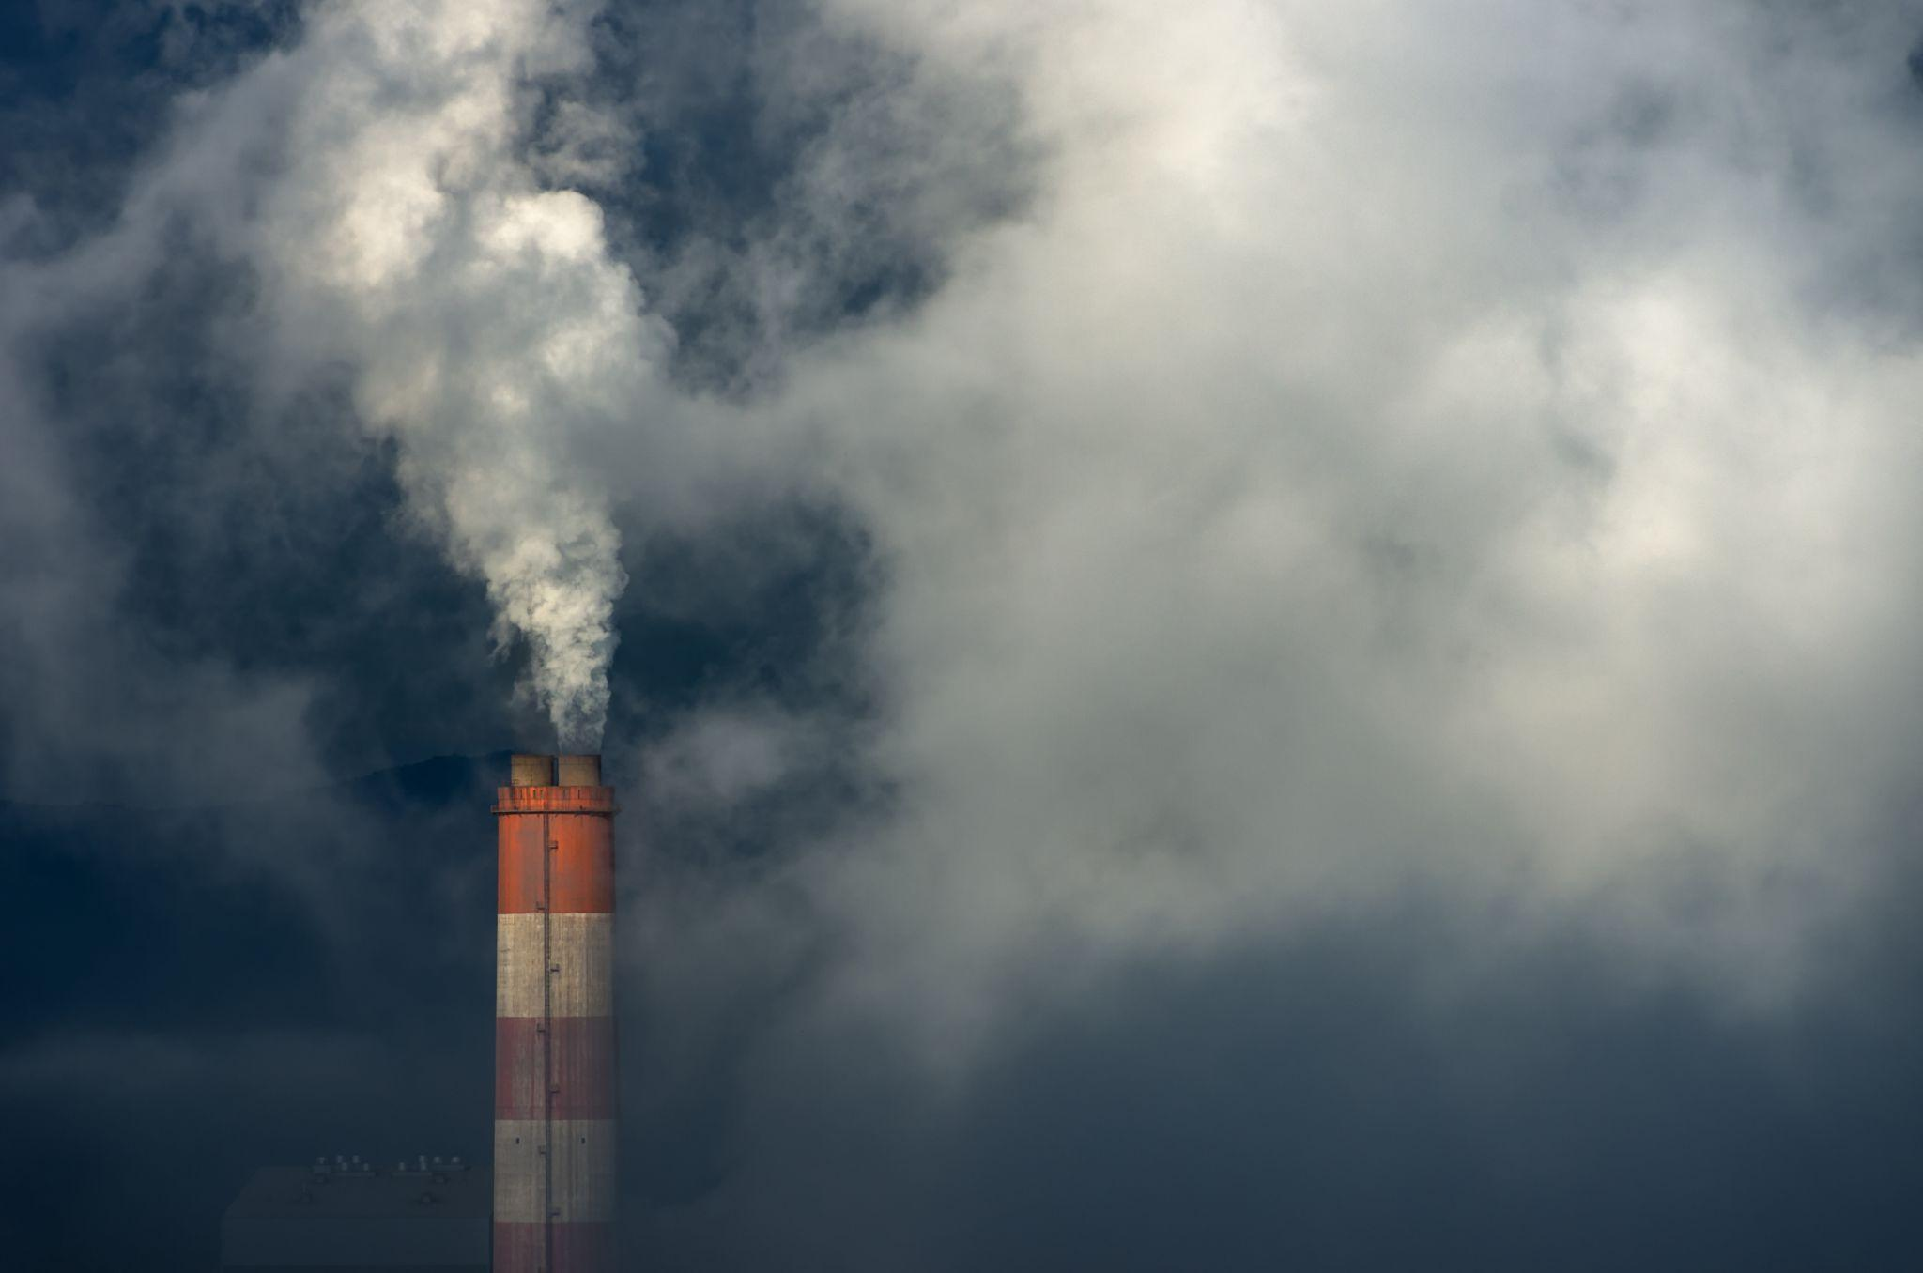
Air
Quality
Index
Understanding Regional
Air Quality Trends in the US
Data Visualization
Laura Gould, Prajwal Nagendra, & Masouma Tajik

Slide 2
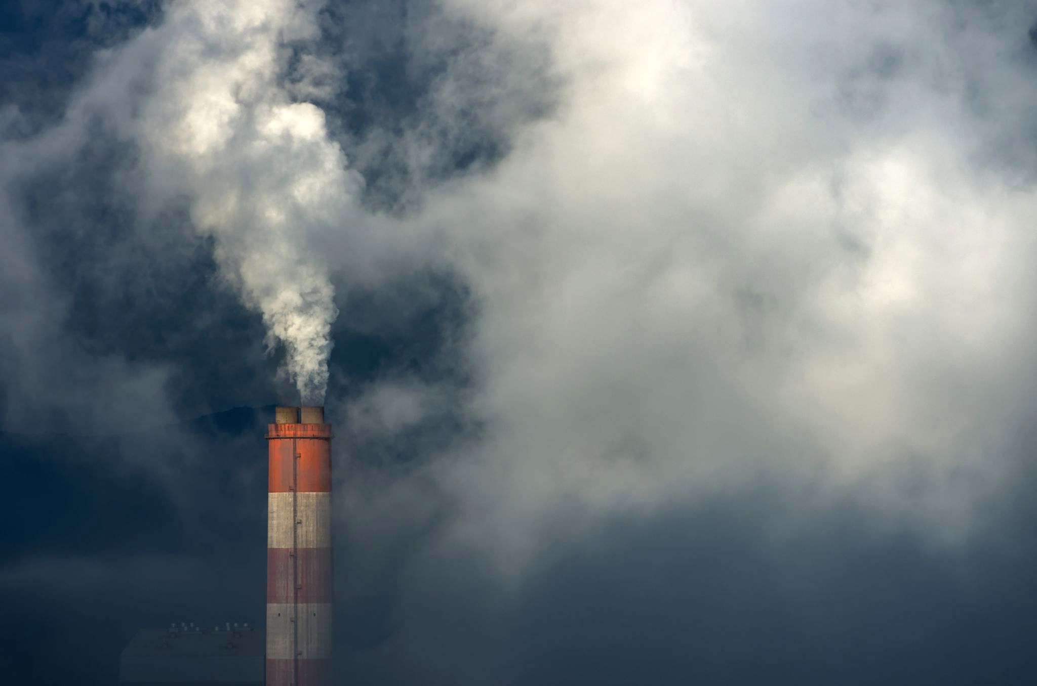
Air Pollution
Air pollution poses a grave threat to public health.
1 in 4 people (over 119 million) in the US face health risks from air pollution.
Disproportionate impacts on communities of color and Western city residents.
Persistent exposure to air pollution leads to long-term health risks such as heart disease, lung cancer, respiratory ailments like emphysema, and potential damage to vital organs like nerves, brain, kidneys, liver. They are also suspected to cause birth defects.
2023 State of the Air report reveals ongoing risks from ozone and particle pollution.
Air pollution, characterized by emissions of greenhouse gases like carbon dioxide (CO2), methane (CH4), and nitrous oxide (N2O, contributes significantly to global warming by trapping heat in the atmosphere, exacerbating climate change.

Slide 3
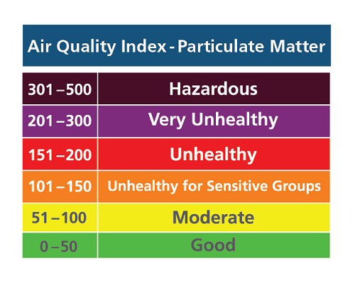
Air Quality Index (AQI)
The Air Quality Index (AQI) is a standardized tool used to measure and communicate the quality of outdoor air by assigning a numerical value that reflects the levels of various pollutants present.
The Air Quality Index (AQI) is maintained and calculated by environmental agencies such as the Environmental Protection Agency (EPA) in the US.
AQI is calculated by measuring pollutant concentrations (PM2.5, PM10, O3, NO2, SO2, CO), converting these into standardized index values, and selecting the highest sub-index as the overall AQI value for a specific location and time.
It employs a scale ranging from 0 to 500, with categories like "Good," "Moderate," "Unhealthy for Sensitive Groups," "Unhealthy," "Very Unhealthy," and "Hazardous" denoting different health risks.

Slide 4
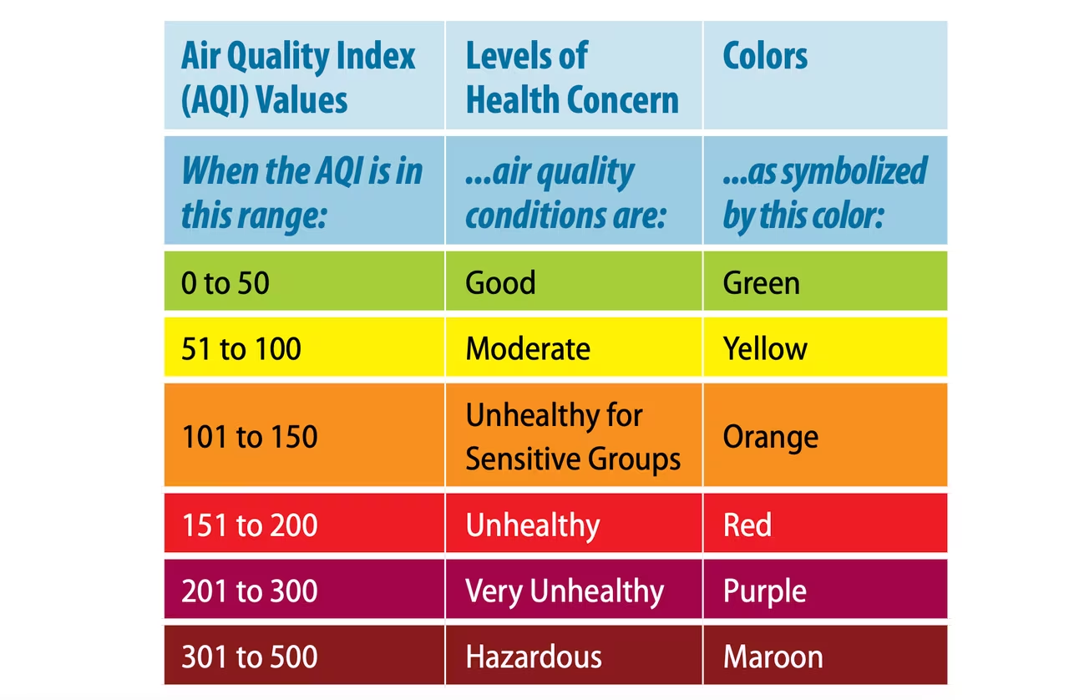

Slide 5
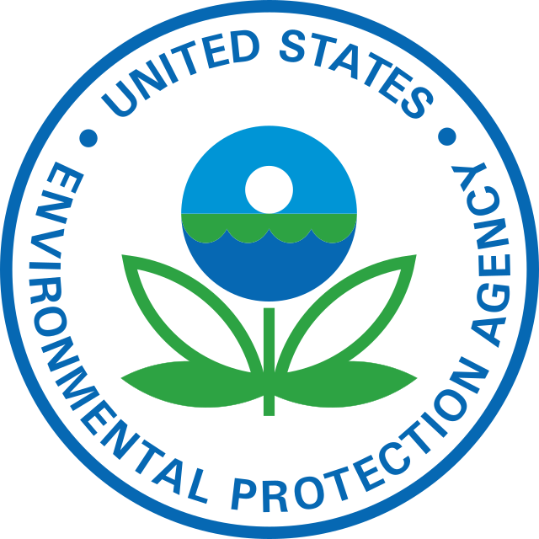
Dataset - AQI Across the US in 2022
Our dataset was sourced from the United States Environmental Protection Agency.
The original dataset consists of 1001 rows and 18 columns.
It is AQI data of 2022 recorded at county level. Currently only 1000 counties out of 3143 counties have recorded AQI. Hence the dataset lacks data on many counties
Variables -
The dataset comprises variables such as State, County, Year, Days with AQI, Good Days, Moderate Days, Unhealthy for Sensitive Groups Days, Unhealthy Days, Very Unhealthy Days, Hazardous Days, Max AQI, 90th Percentile AQI, Median AQI, Days CO, Days NO2, Days Ozone, Days PM2.5, and Days PM10, providing comprehensive information on air quality parameters across different regions and timeframes.

Slide 6
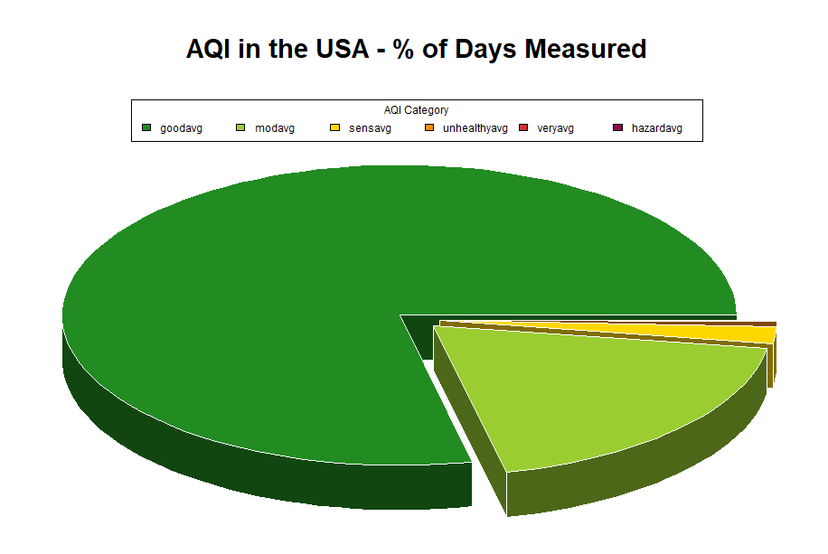
AQI was Good on Most Days Across the USA

Slide 7
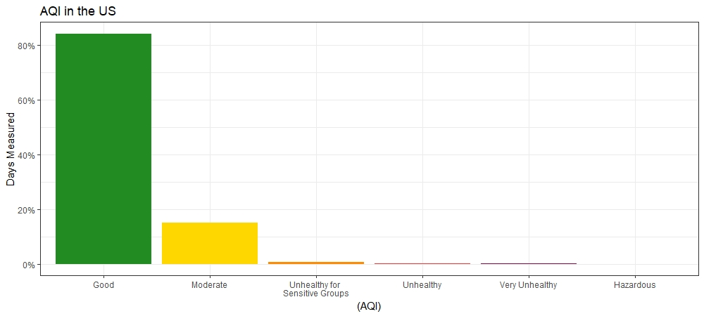
AQI was Good on Most Days Across the USA

Slide 8
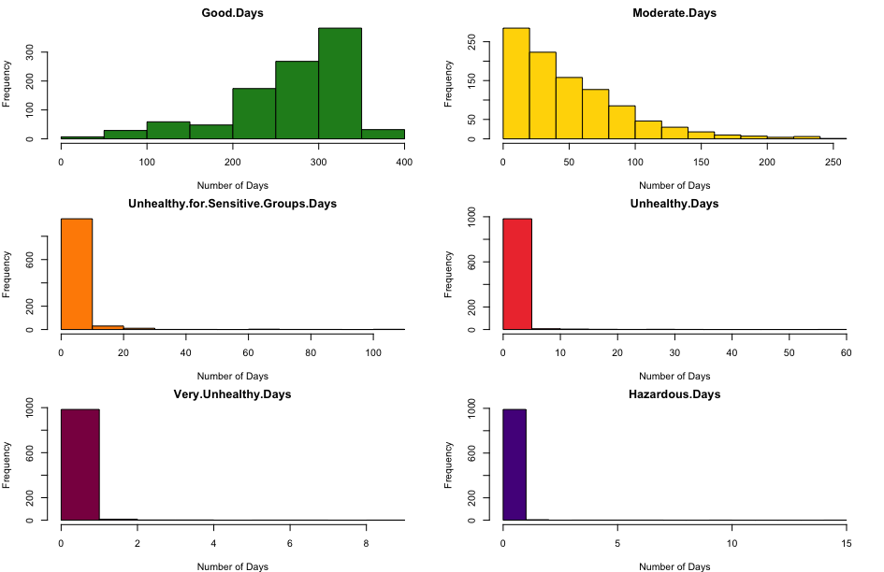
Days are Mostly Good

Slide 9
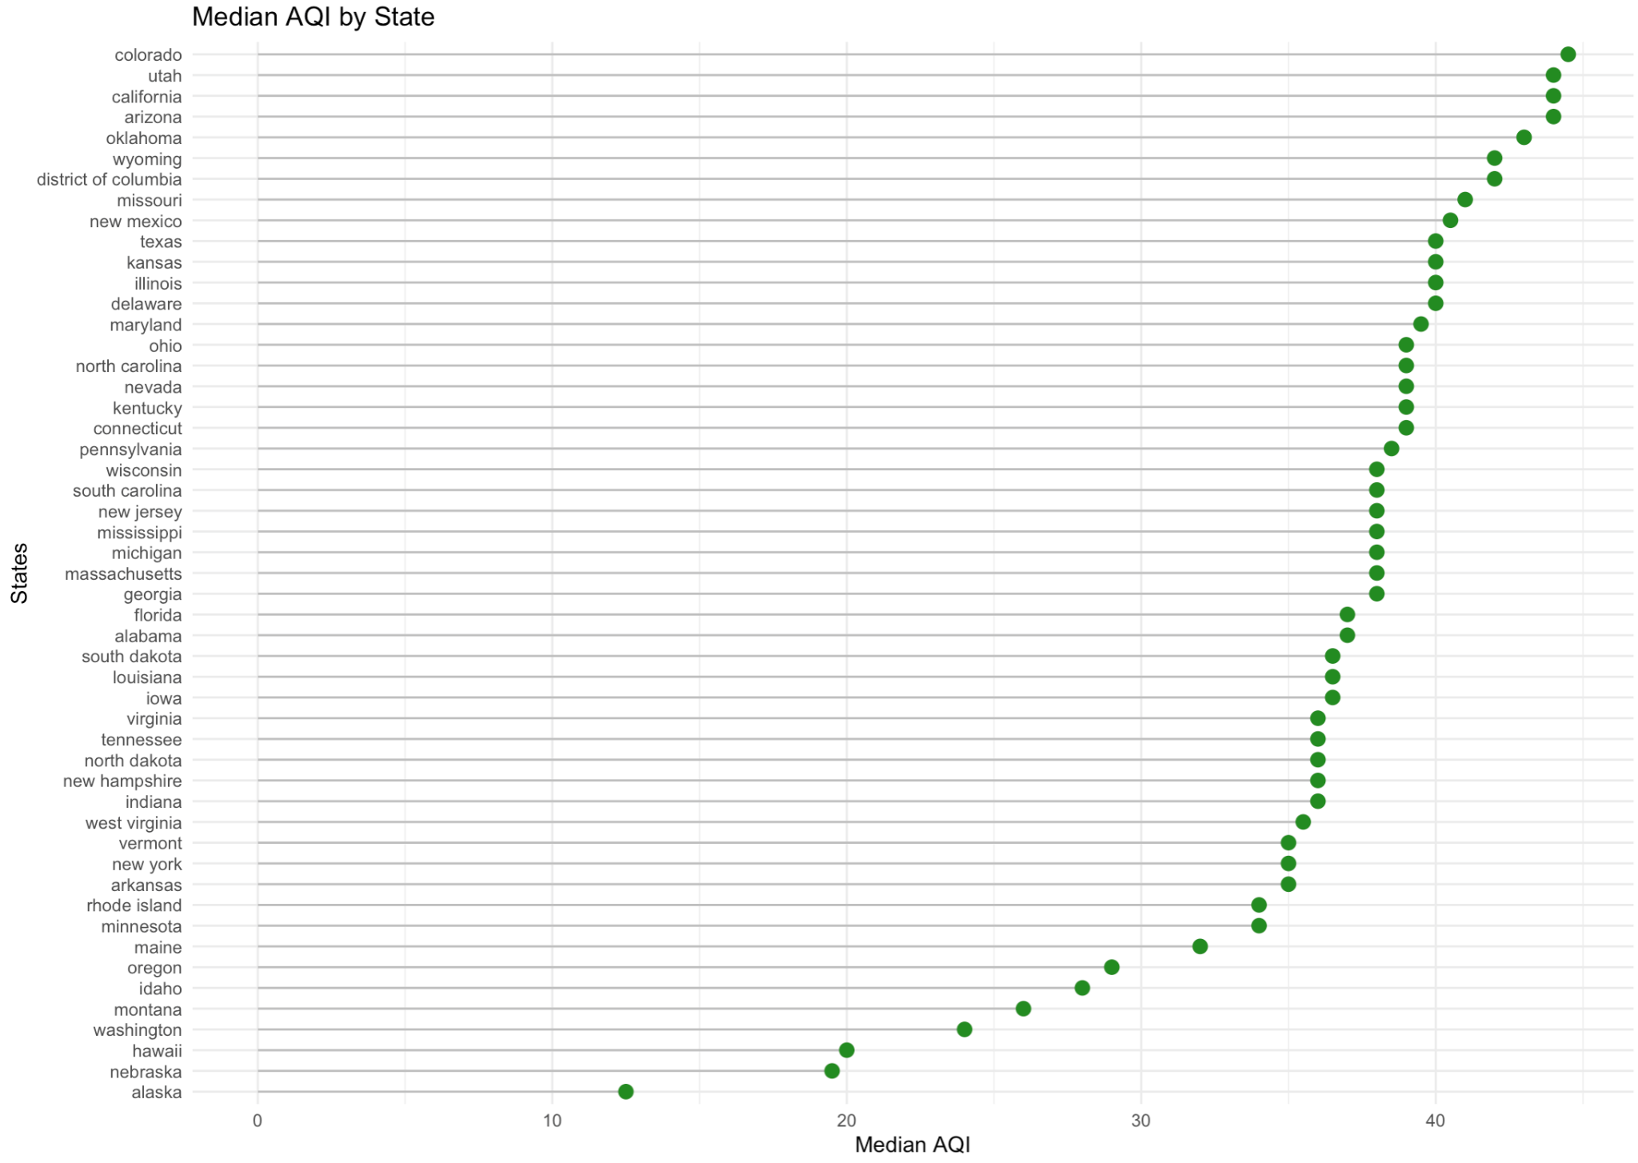
All Median AQIs by State are Good

Slide 10
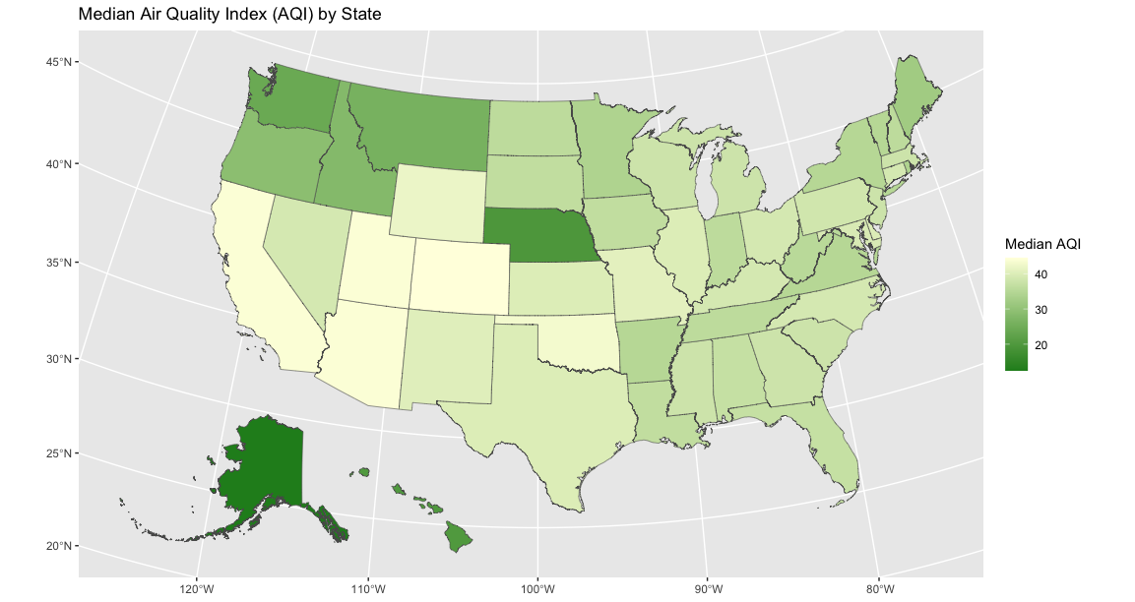
Choropleth map showing Median AQI

Slide 11
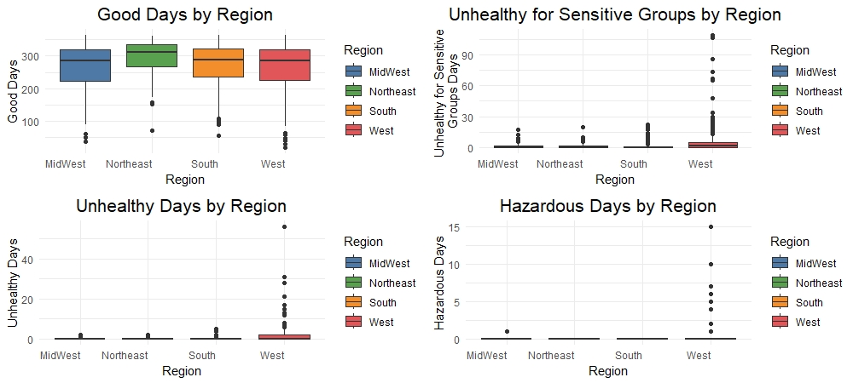
West has Fewer Good Days; More Hazardous Days

Slide 12
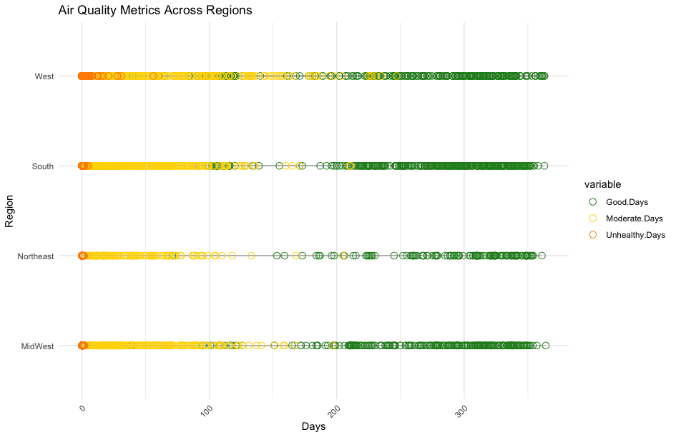
Air Quality Metrics across Regions

Slide 13
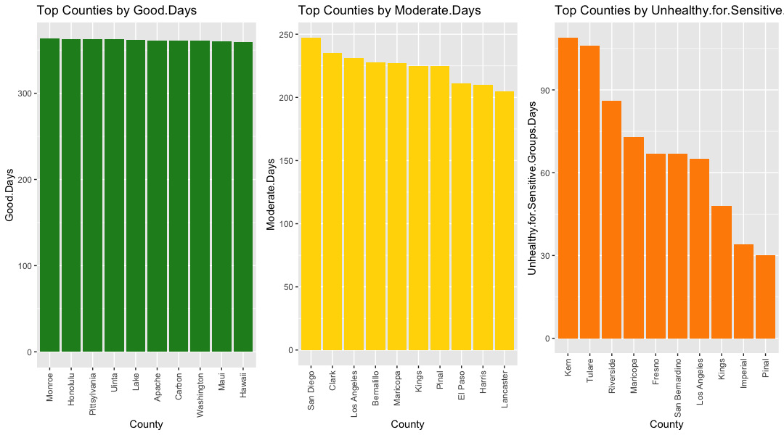
Counties of Least Concern

Slide 14
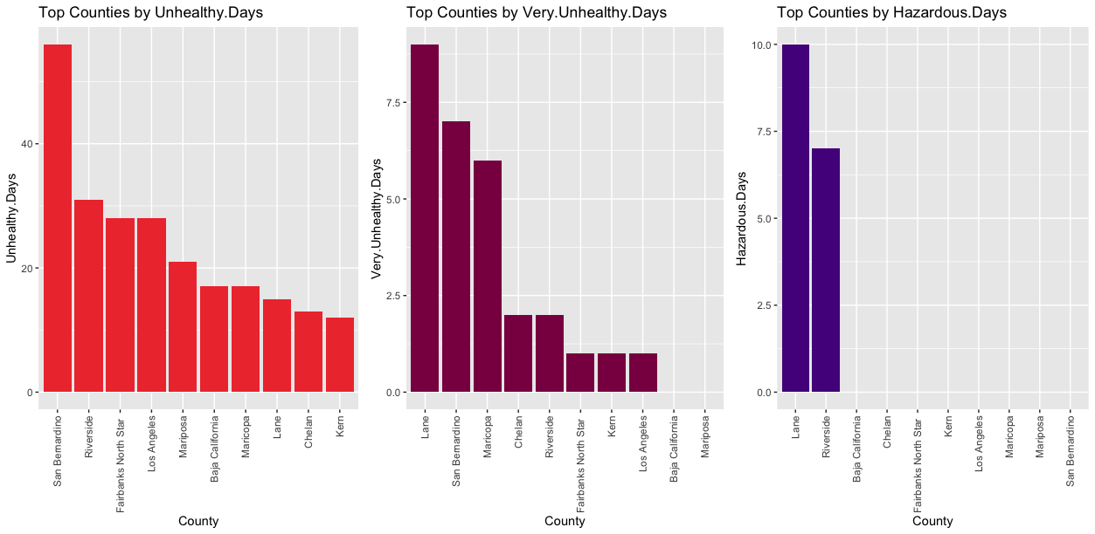
Counties of Least Concern

Slide 15
Mapping AQI Days

Slide 16
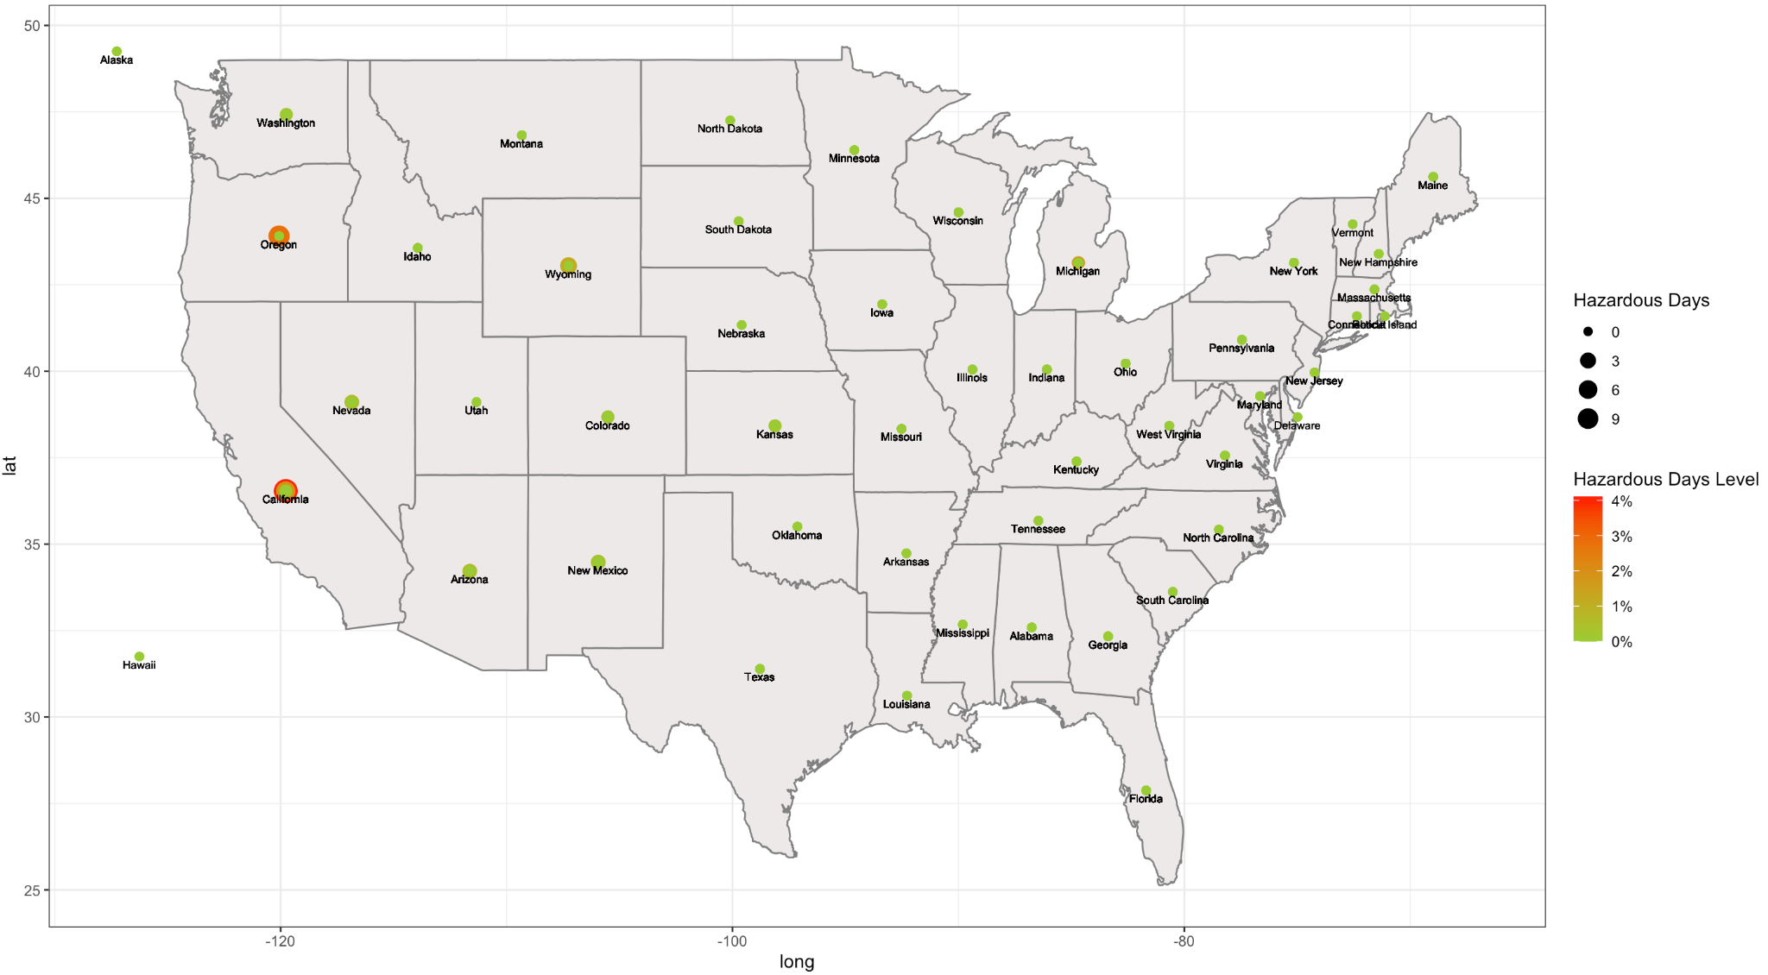
Hazardous Days by State

Slide 17
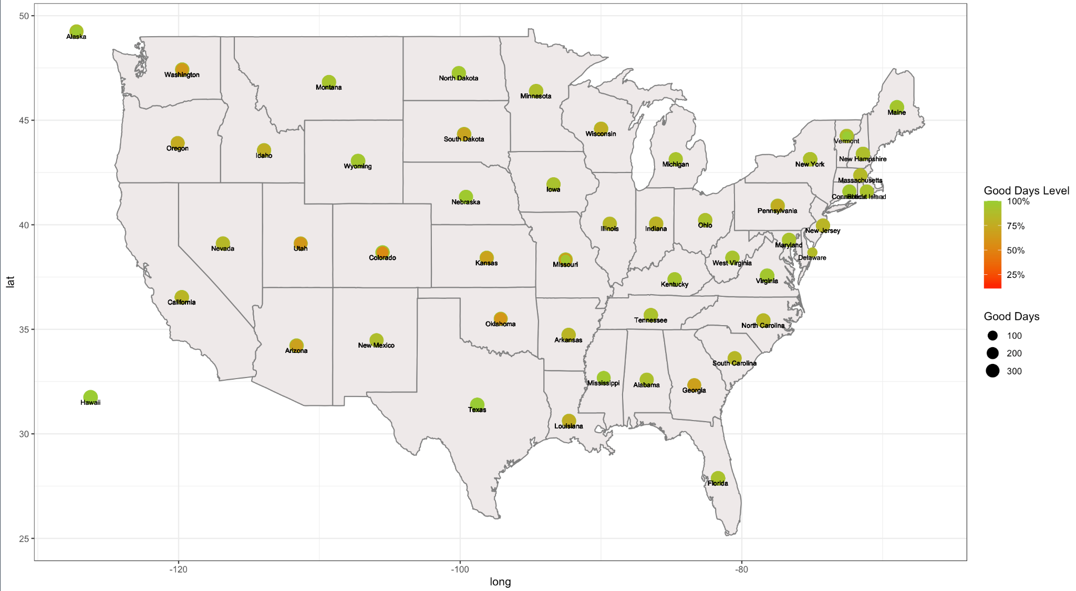
Good Days by State

Slide 18
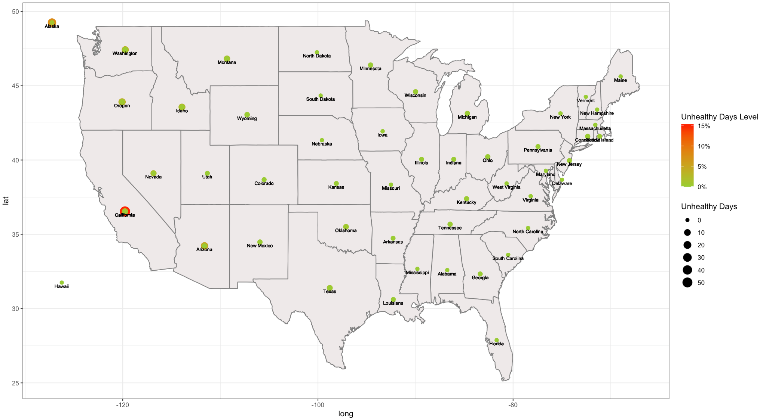
Unhealthy Days by States

Slide 19
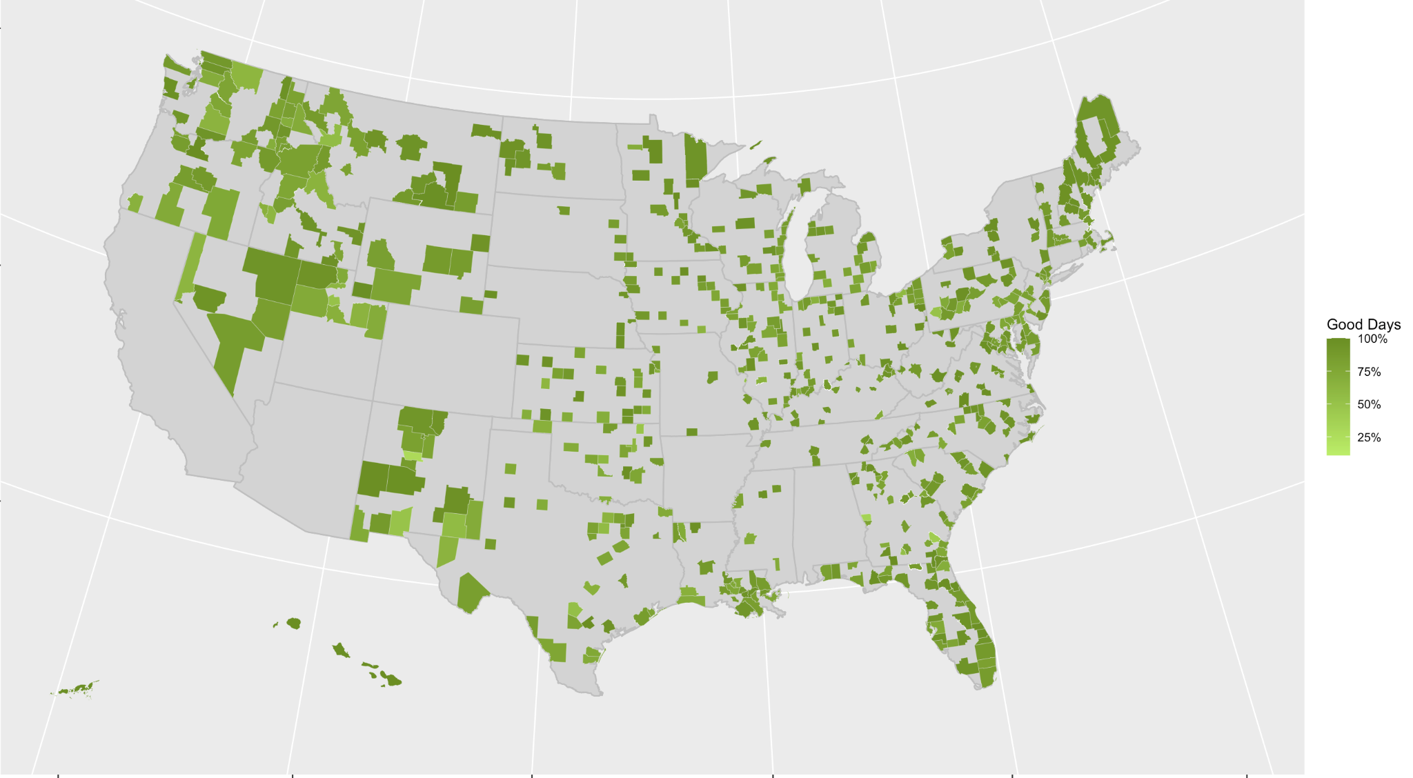
% Good Days by County

Slide 20
Pollutant Data

Slide 21
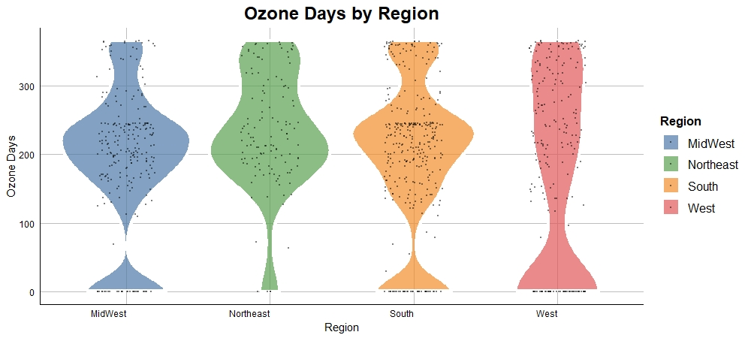
All Regions Have Ozone Issues

Slide 22
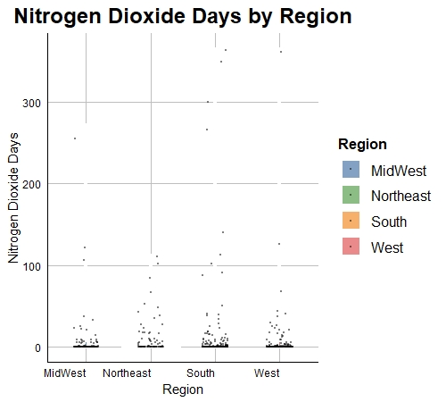

Very Little NO2 or CO Exposure in 2022

Slide 23
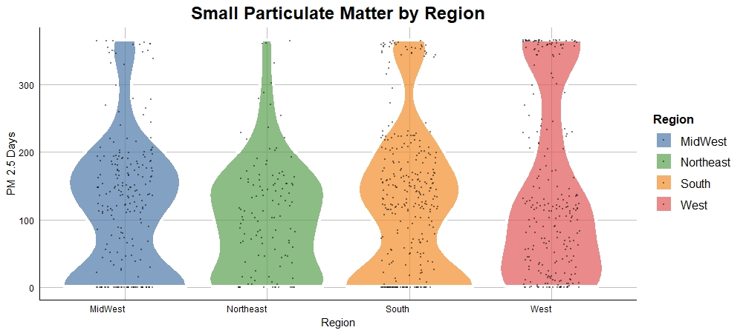
MidWest and South Struggling with Particulate Matter

Slide 24
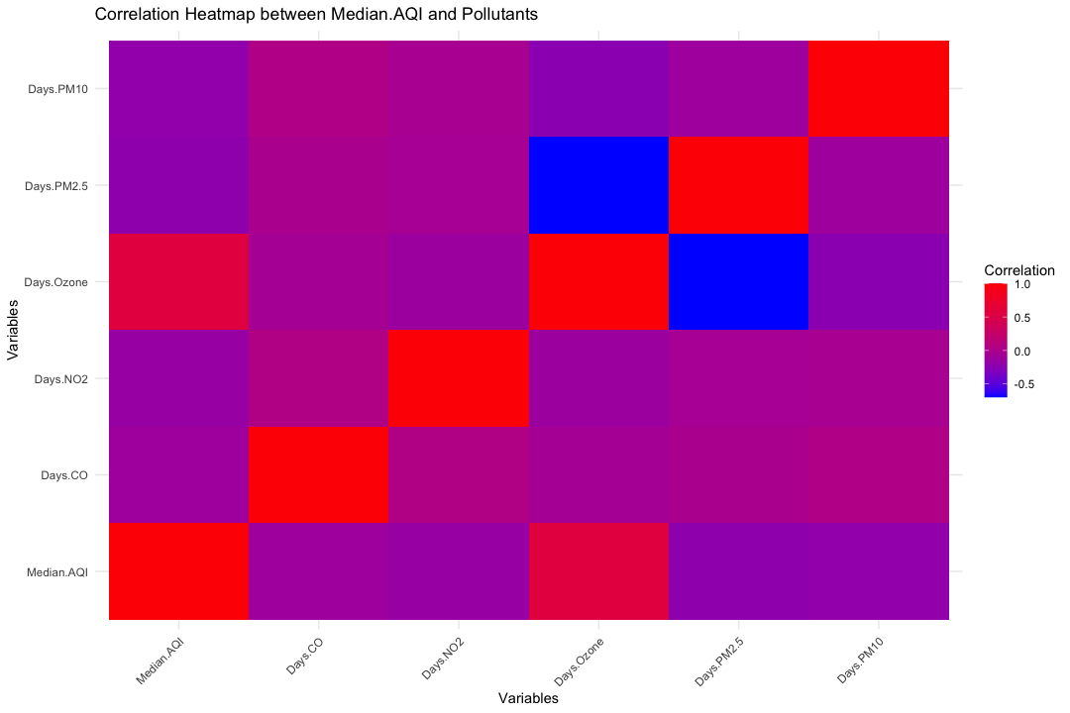
Ozone is Highly Correlated with Median AQI

Slide 25
FINAL CONCLUSIONS
AQI Overview
Most days are good
South and West are struggling with air quality in 2022
Mapping
California and Oregon have poor air quality - wildfires
Data is very spread out
Pollutants
Concentration varies a lot by pollutant, and varies somewhat by region
Ozone seems to be the main driving criteria for AQI

